Slide 1

SYNOPSYS TOOLS GUIDELINES
ĐẠI HỌC QUỐC GIA TP.HỒ CHÍ MINH
TRƯỜNG ĐẠI HỌC BÁCH KHOA
KHOA ĐIỆN-ĐIỆN TỬ
BỘ MÔN KỸ THUẬT ĐIỆN TỬ

Slide 2
AGENDA
Design Flow
Circuit Design Guidelines
Layout Design Guidelines

Slide 3
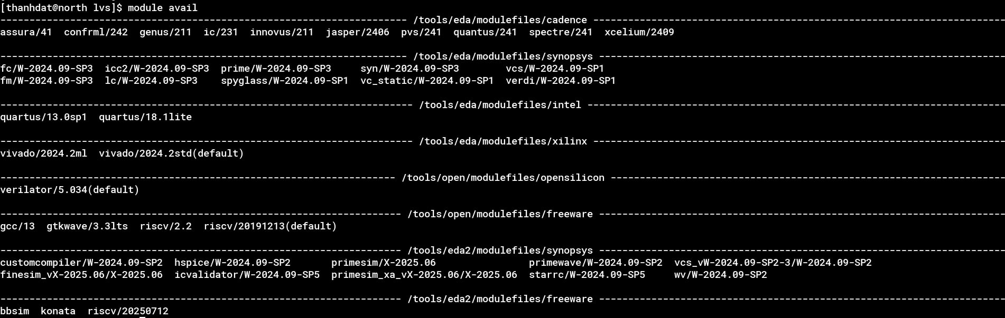
Design Flows
Synopsys Custom Compiler is a full-custom IC design environment optimized for analog, mixed-signal, and custom digital design. Similar to Virtuoso, Custom Compiler is designed for schematic and layout design, as well as DRC/LVS checks and more. Design Flow
Schematic Design
Tool: Custom Compiler
Pre-sim
Tool: PrimeWave
Layout
Tool: Custom Compiler
LVS/DRC check
Post-sim
Optimize
Simulator: Hspice/Primesim/ Finesime
Tool: IC Validator
Extraction Tool: starrc
Waveview: wv
According to the diagram, we must install the tools as mentioned in order to proceed with the design:
module avail to show the available tools
module load <tool_name> to install the tool
Examples:

Slide 4
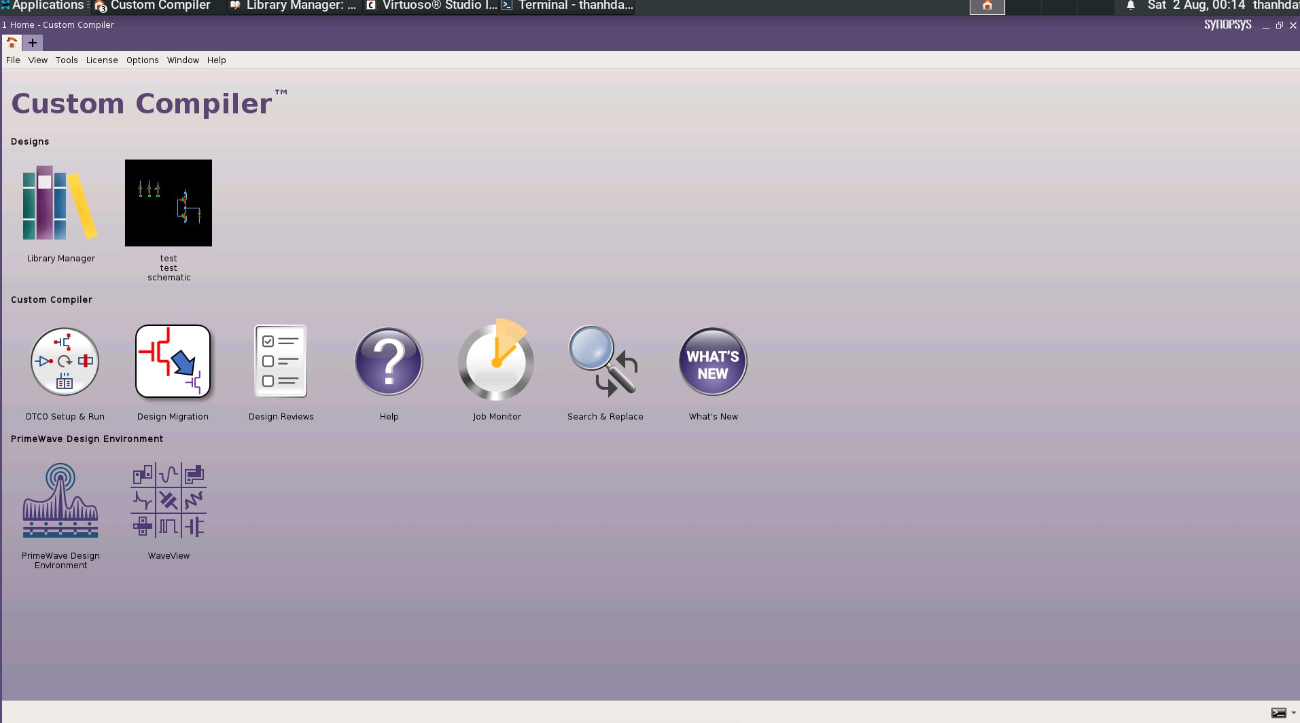
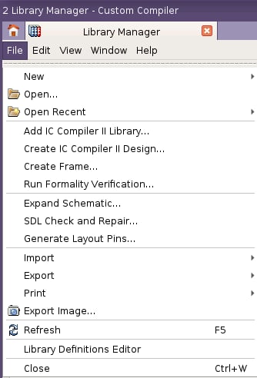
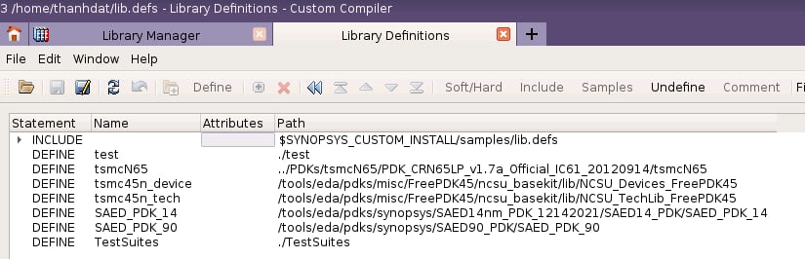
Circuit Design Flow
After installing the necessary tools, open Custom Compiler (CC) to start designing the circuit: custom_compiler &
Click on Library Manager to open the library management tool
In the Library Manager tab, open Library Definitions Editor to access lib.defs and import PDK
Library Manager

Slide 5
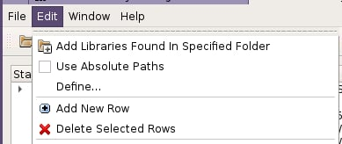
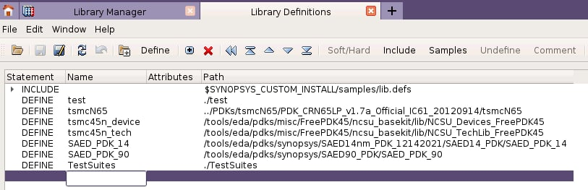
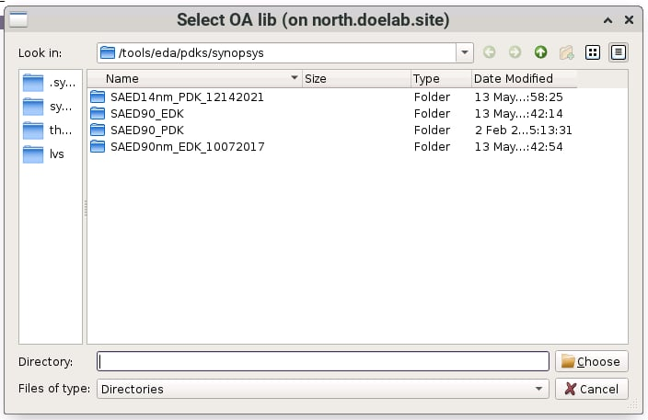
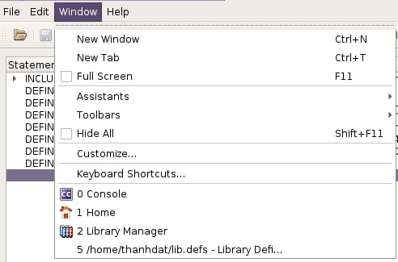
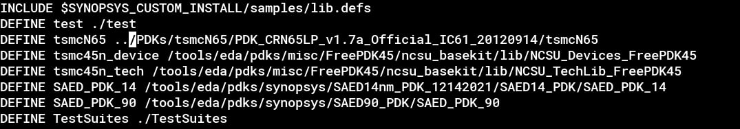
Circuit Design Flow
Import PDK
There is two methods to import PDK into Custom Compiler
Using Gui to import PDK
Click on the empty space below the last row
Choose Edit → Define ... → Choose the required PDK
Define PDK in the lib.defs file
3
2
1
In the window tab, there is the lib.defs dir. We can open it to import PDK

Slide 6
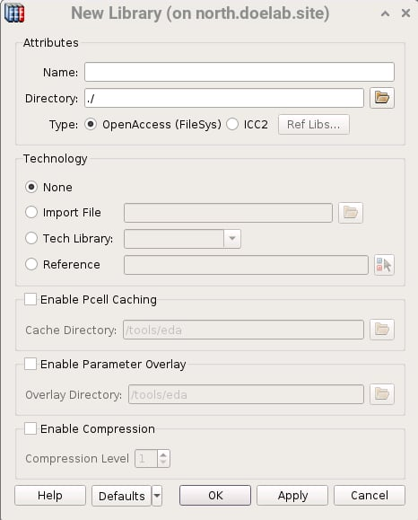
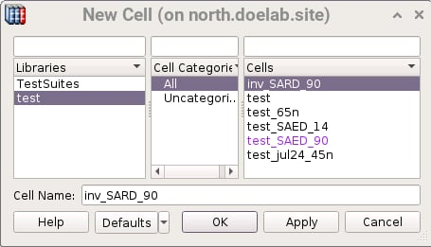
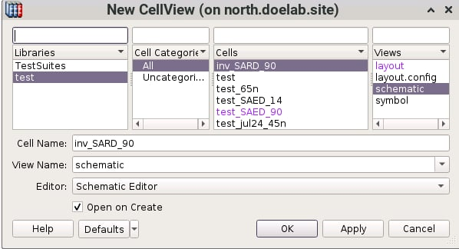
Circuit Design Flow
(1)
(2)
Schematic Design
In the Library Manager tab, choose
New → Library: create the new lib (1)
Name: Define the library name
New → Cell: create the new cell (2)
Cell Name: Define the cell name
New → CellView: create the new cellview (3)
View Name: Define the view name
Editor: Choose type of cellview, such as: Schematic Editor, Layout Editor,...
(3)

Slide 7
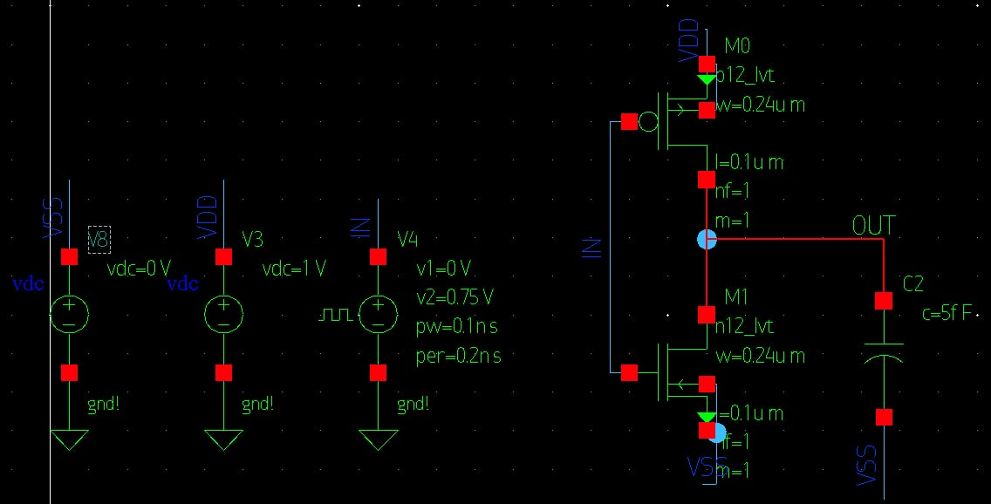
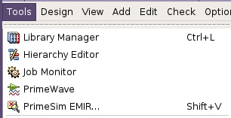
Circuit Design Flow
Schematic Design
In the Schematic editor, build a testbench, such as an inv:
Keyboard shortcuts similar to Virtuoso:
I: Add instance
W: Draw net
L: Name net
P: Add pin ...
After completing the schematic, select Tools → PrimeWave to simulate the circuit
Set up like as ADE L to run presim

Slide 8
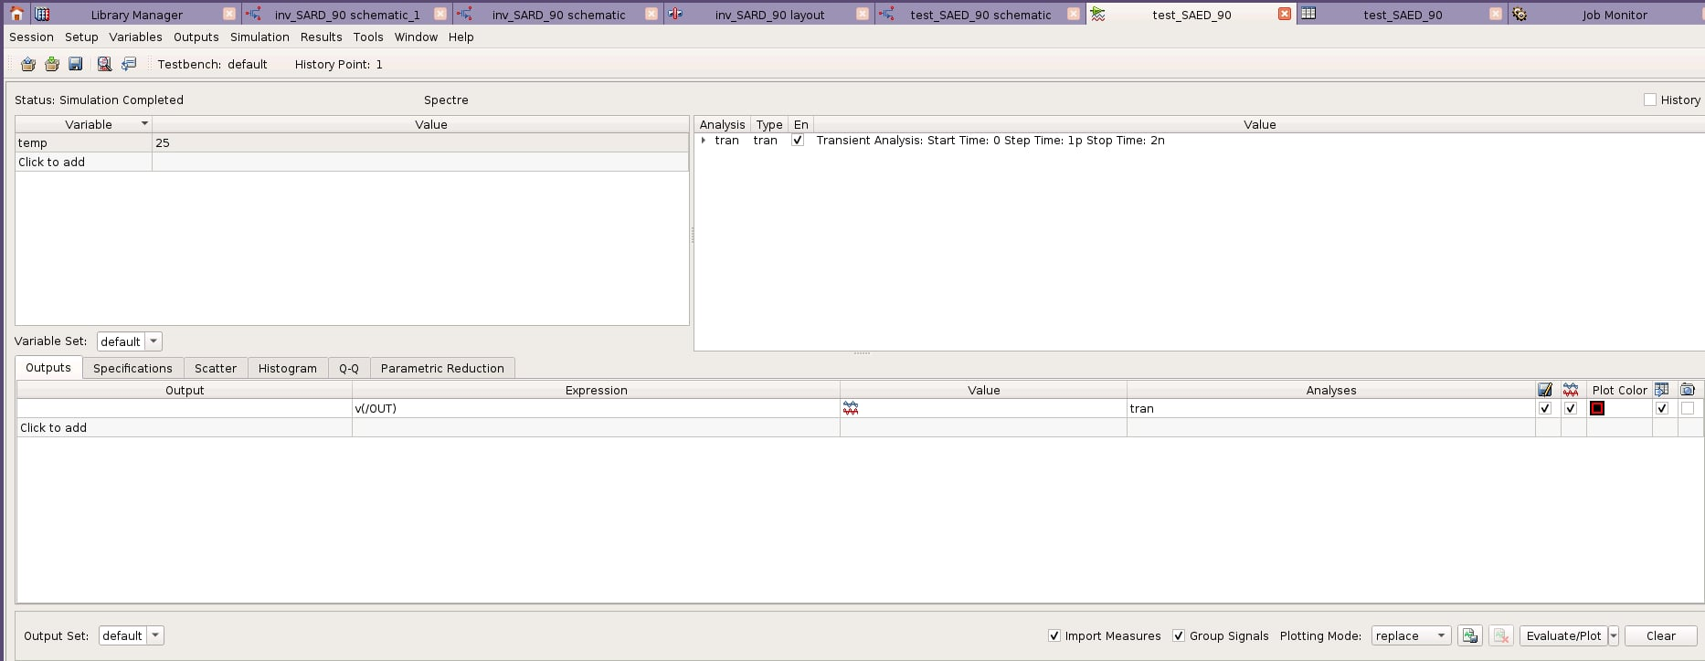
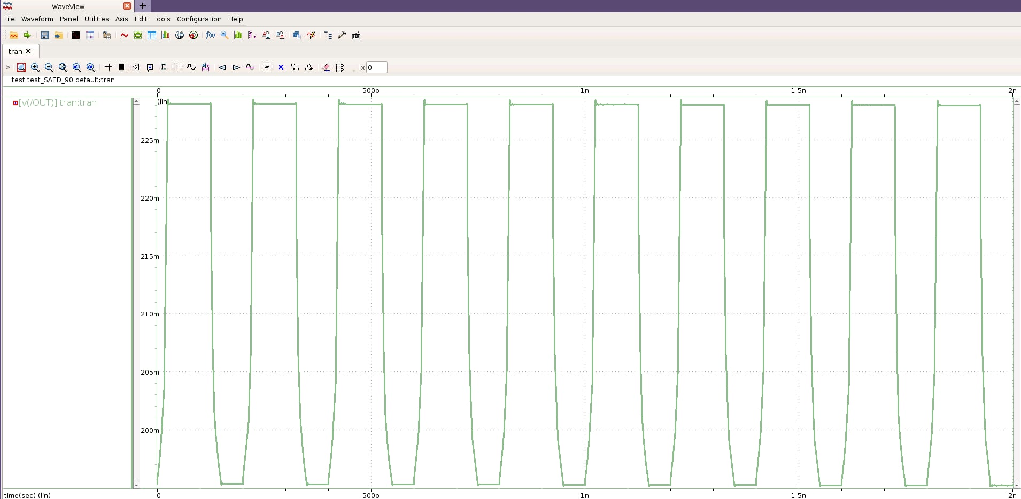
Circuit Design Flow
Schematic Design
Config Primewave to run transient:
We get the waveform at the output inv

Slide 9
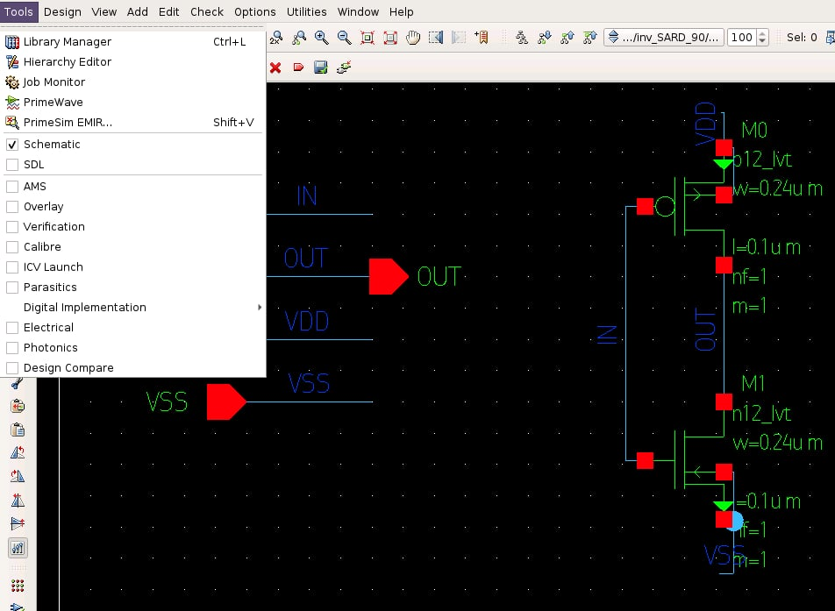
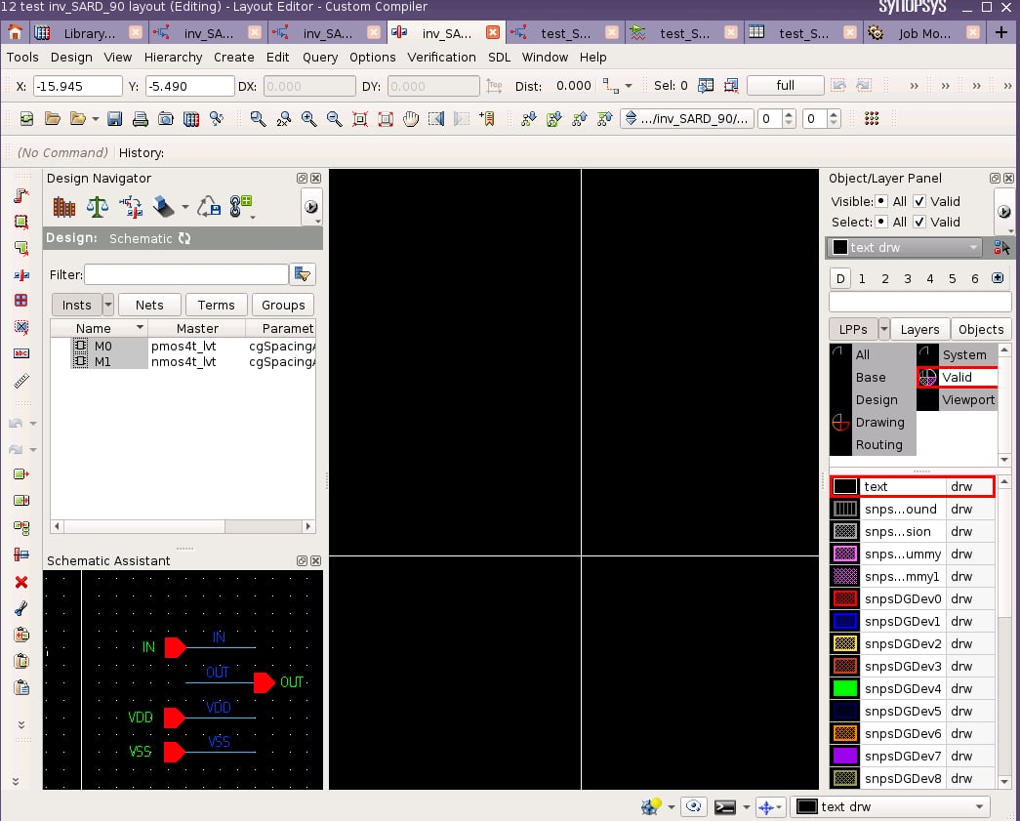
Layout Design Flow
Layout Design
After create the schematic of a cell, choose Tools → SDL to generate the layout view

Slide 10
Layout Design Flow
Layout Design
After create the schematic of a cell, choose Tools → SDL to generate the layout view
TBU

